Slide 1
Interview Part -2
Answers

Slide 2
Task -1

Slide 3
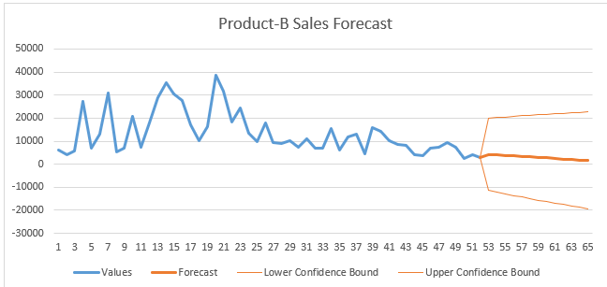
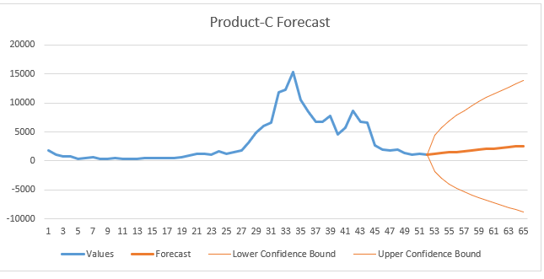
Task - 1
Product-B
Product-c

Slide 4
Product - B

Slide 5
Product - B
Product B as been more potential in terms of sales in each season specially in the spring as per the season and rain forecast was been compared.
Product B has the highest selling ratio compared with Product C.
It has the highest selling rate in Week 21 and it is all time highest which was 2x times than Product C highest sales.
Product B can be assumed as Shoes as they are the most sold in Dry seasons and Least performing in Rainy Seasons.

Slide 6
Product - C

Slide 7
Product - C
It is one of the seasonal product which is moderate in sales.
The highest sales of this product is only 15k aprox.
As it is a season product it is assumed that this is an electrical Fan or Flip-Flops or Beach wear

Slide 8
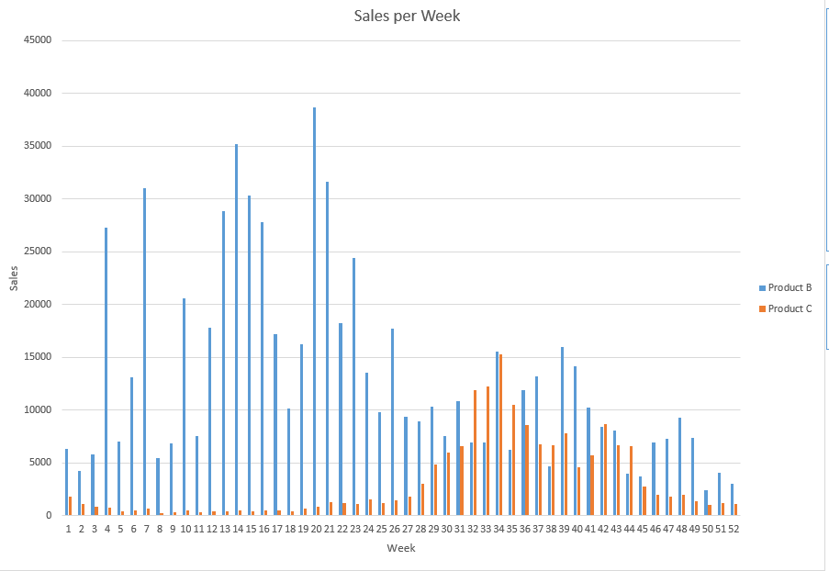
Sales of Both Product

Slide 9
Task - 2

Slide 10
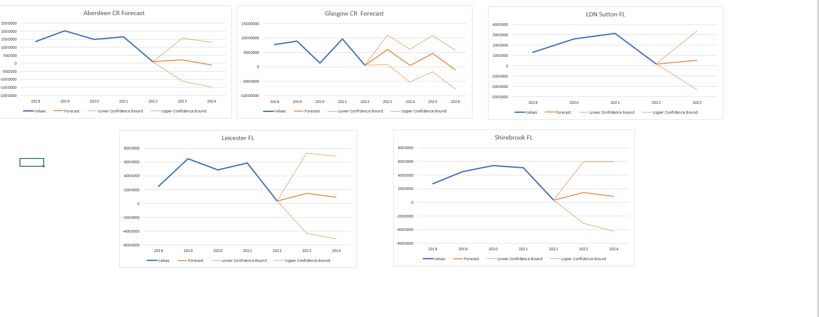
Predictions

Slide 11
Description for Predictions
As per the graphical representations the highest potential for sales in the coming year is of London followed by Shirebrook.
The Highest Sales recorded from current cities is in Glasgow but somehow when we compare the final results including all store the highest sales are in Shirebrook store.
Choosing Leicester Store is not going to be profitable much compared to Glasgow which is the best performing in all store.

Slide 12
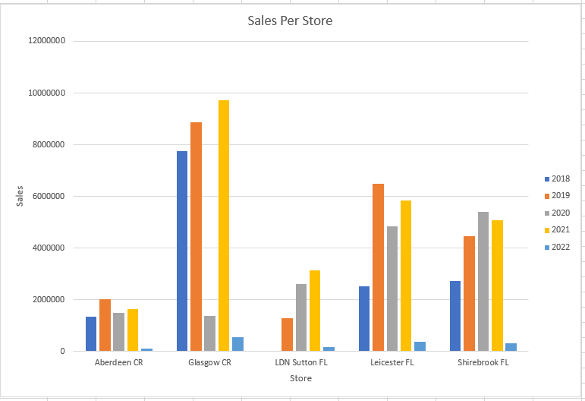
Stores Sales Per Year

Slide 13
Answering your Questions
Task – 1
Comparing with the temperature and rain forecast the assumption(H0 or Null Hypothesis) suggest that the following data represents the sales of footwear in seasons and to learn how I have forecast the I have utilized the given data and analysed using pivot table and then by Excel Forecast Tool
Task – 2
I selected those 5 stores with the comparison of highest lowest and most best performing stores and took a chance to follow my gut feeling with these stores.
I have forecast the data based upon yearly sales and also attached a dashboard which will help to resolve the problems based upon days, week, months and years with store by store option to choose.

Slide 14
Thanks You for your Time

